Slide 1


Hello! Project 3 by T. Abeer Ali Alnuaim

Slide 2

Introduction
My little library is:
An electronic library developed for children to benefit from on computers and develop their educational skills

Slide 3
The goals are :
Entertainment
Kids can have fun when they using the computers
Education
In order to benefit from learning what works for them

Slide 4
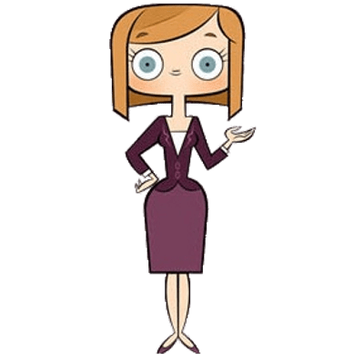
Project Scope
The library targeted age group from 3-7 .

Slide 5
Functional Requirements

Slide 6
Sections
Functional Requirements
أختبر نفسك
تعلم
عالم القصص

Slide 7
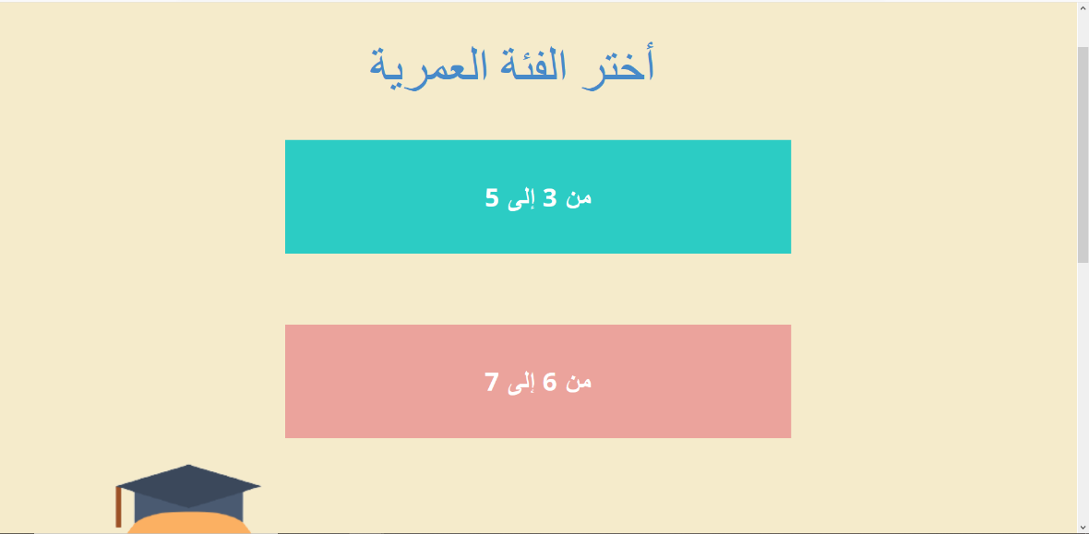
Functional requirements
The library is classified them as two age categories:
Shown in the picture

Slide 8
Functional Requirements
The system shall be able to create an account for the user and it save the information that he entered when creating an account in the (Sign-up), in case the user wants to log in.

Slide 9
Problem

Slide 10
One of the problems in this generation is the children using an electronic device on a daily basis, without goal which leading to reduces their focus, and distracts them from their attention, so this is a very negative thing for the children and that may reduce their contact with the family.

Slide 11
Solution

Slide 12
We help children benefit most of their time, we developed a library helping children to enjoy the computer in their education and we help parents to acquire their children to useful and fun information at the same time, so we developed a web site called “My Little Library”.

Slide 13
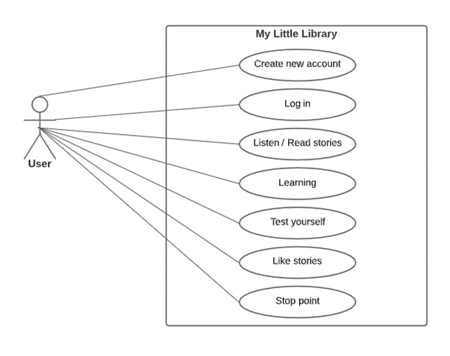
System Analysis
System use-case
Shown in the picture

Slide 14
My little library :
Its Easy to use
The interfaces are understandable and a way to deal with them can be known
The existing sections are wonderful, consistent with each other

Slide 15
Thanks!
Any questions? You can find us at:
Email : MyLittleLibraryTeam@gmail.com
Twitter Account: @mylittlelibray

Slide 16
Thanks for watching and listening
حصه المسعد
نجود العرفج
العنود فراج
أفنان باوزير
❤

